Slide 1
vSlam-Zero
A toy implementation of visual-based monocular simultaneous localization and mapping

Slide 2
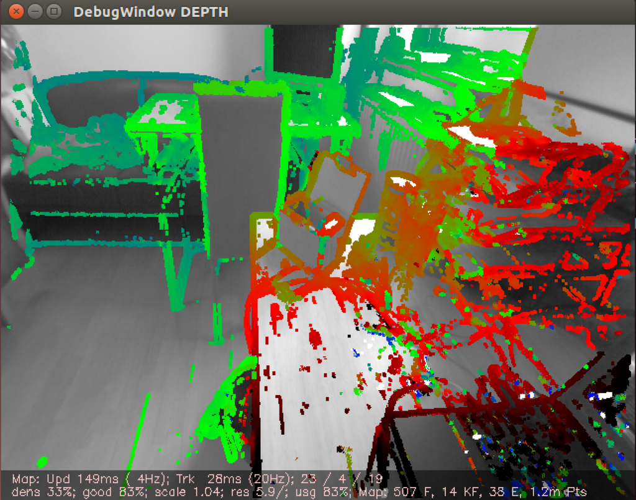
Project Overview
SLAM
Simultaneous localization and mapping
Map unknown environment
Track localization
vSLAM
Visual SLAM
Monocular
Camera based
Application to driving footage
This Photo by Unknown Author is licensed under CC BY

Slide 3
Project Inspiration
George Hotz Twitch-SLAM livestream
ORB-SLAM papers 1 and 2
Visual SLAM: From Theory to Practice
Personal interest in the domain of autonomous vehicles

Slide 4
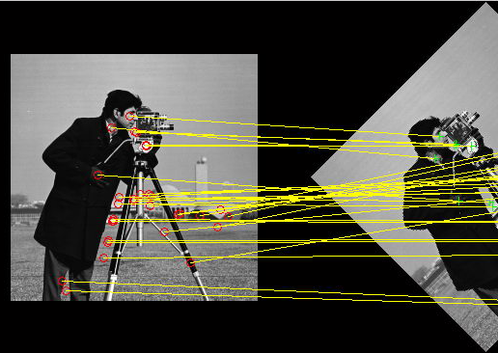
My approach
Three steps
Feature matching between sequential images (BRIEF, Brute Force)
Pose transformation estimation (8-point algorithm)
Triangulate world points
Implemented using NumPy's linear algebra features and open-cv python libraries.
This Photo by Unknown Author is licensed under CC BY-SA

Slide 5
Experimental Results and Demonstration

